Slide 1

NYC TAXI TRIP
PROJECT BY :
RANJAN PRANAV
SAWANT VIDISHA VIJAY
THALLA MOUNIKA
CRN: 27960 GROUP 8

Slide 2

PROJECT CONTENT
INTRODUCTION
PROBLEM DEFINITION
DATASET USED
VISUALIZATION
RESULT
CONCLUSION

Slide 3


INTRODUCTION
YELLOW TAXIS ARE ICONIC AND OFFICIAL TAXIS IN NYC.
YELLOW TAXIS HAVE THE RIGHT TO PICK UP STREET-HAILING AND PREARRANGED PASSENGERS ANYWHERE IN NEW YORK CITY
GREEN TAXIS ARE NEW TO THE CITY SINCE 2013.
GREEN TAXIS ARE ALLOWED TO PICKUP PASSENGERS IN NORTHERN MANHATTAN AND ANYWHERE IN THE BRONX, BROOKLYN, STATEN ISLAND AND QUEENS EXCLUDING THE AIRPORTS AND CAN DROP-OFF ANYWHERE WITHOUT RESTRICTION.

Slide 4
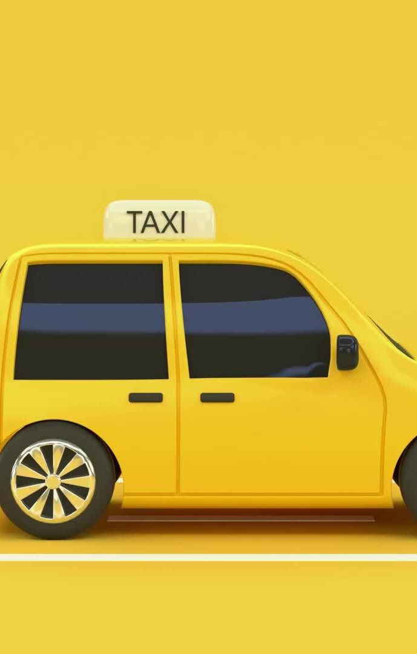
PROBLEM DEFINITION
The NYC yellow taxi data of year 2021 and the green taxi data of year 2021 contains the data of each trips, its distances, the amount it cost for each trip and many more things. The NYC taxi can utilize the data analysis which we have done and can help them improve their rides in future for better services.

Slide 5
DATASET USED
NYC YELLOW TAXI YEAR 2021
NYC GREEN TAXI YEAR 2021
FROM TLC New York Website
Python Project Group 8

Slide 6
IEEE RESEARCH PAPER REFERRED
https://ieeexplore-ieee-org.rlib.pace.edu/document/8258070
https://ieeexplore-ieee-org.rlib.pace.edu/document/8258070
https://ieeexplore-ieee-org.rlib.pace.edu/document/9403054
https://ieeexplore-ieee-org.rlib.pace.edu/document/8817347

Slide 7
Objective
Loaded Data
Check Data Columns
Drop NULL Values
Box Plot
Histogram
HeatMap
Merging
Slicing
Matrix Form
Uploaded Data to NumPy
Used Libraries such as Pandas, Numpy, Seaborn, Matplotlib.
Created Classes and functions.

Slide 8
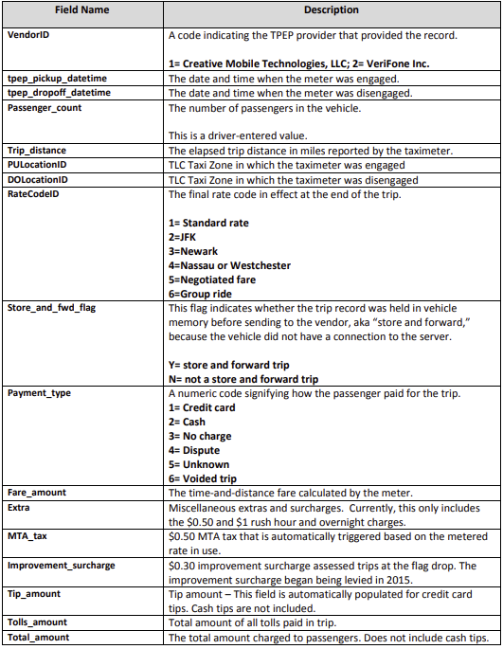
DATA DICTIONARY OF NYC YELLOW TAXI

Slide 9
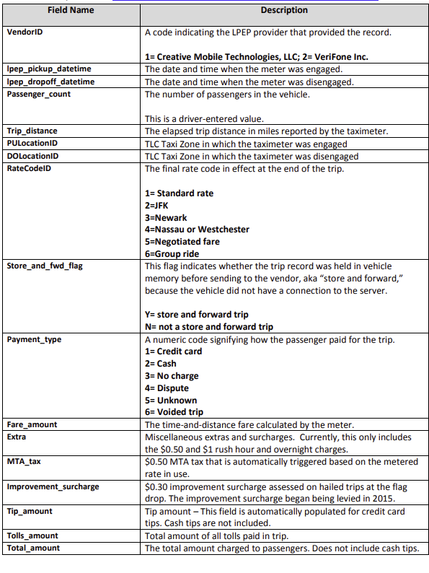
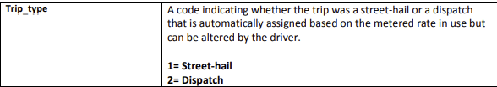
DATA DICTIONARY OF NYC GREEN TAXI

Slide 10
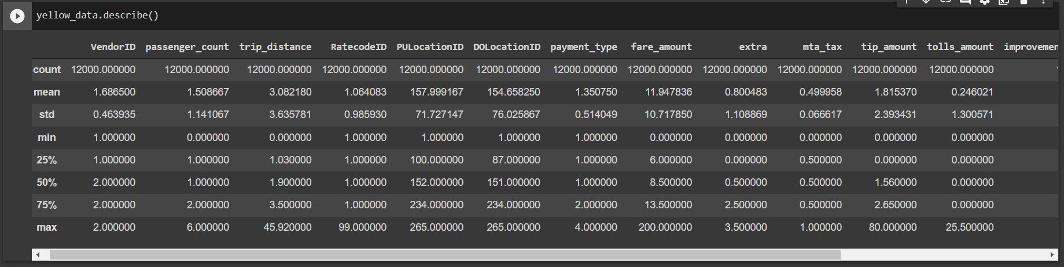
Yellow Taxi Dataset

Slide 11
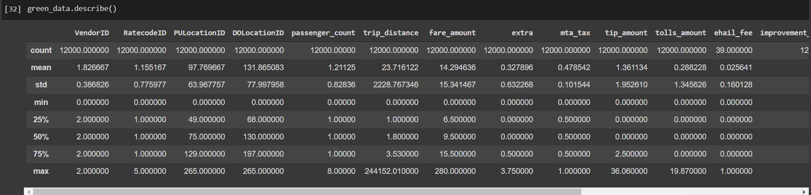
Green Taxi Dataset

Slide 12
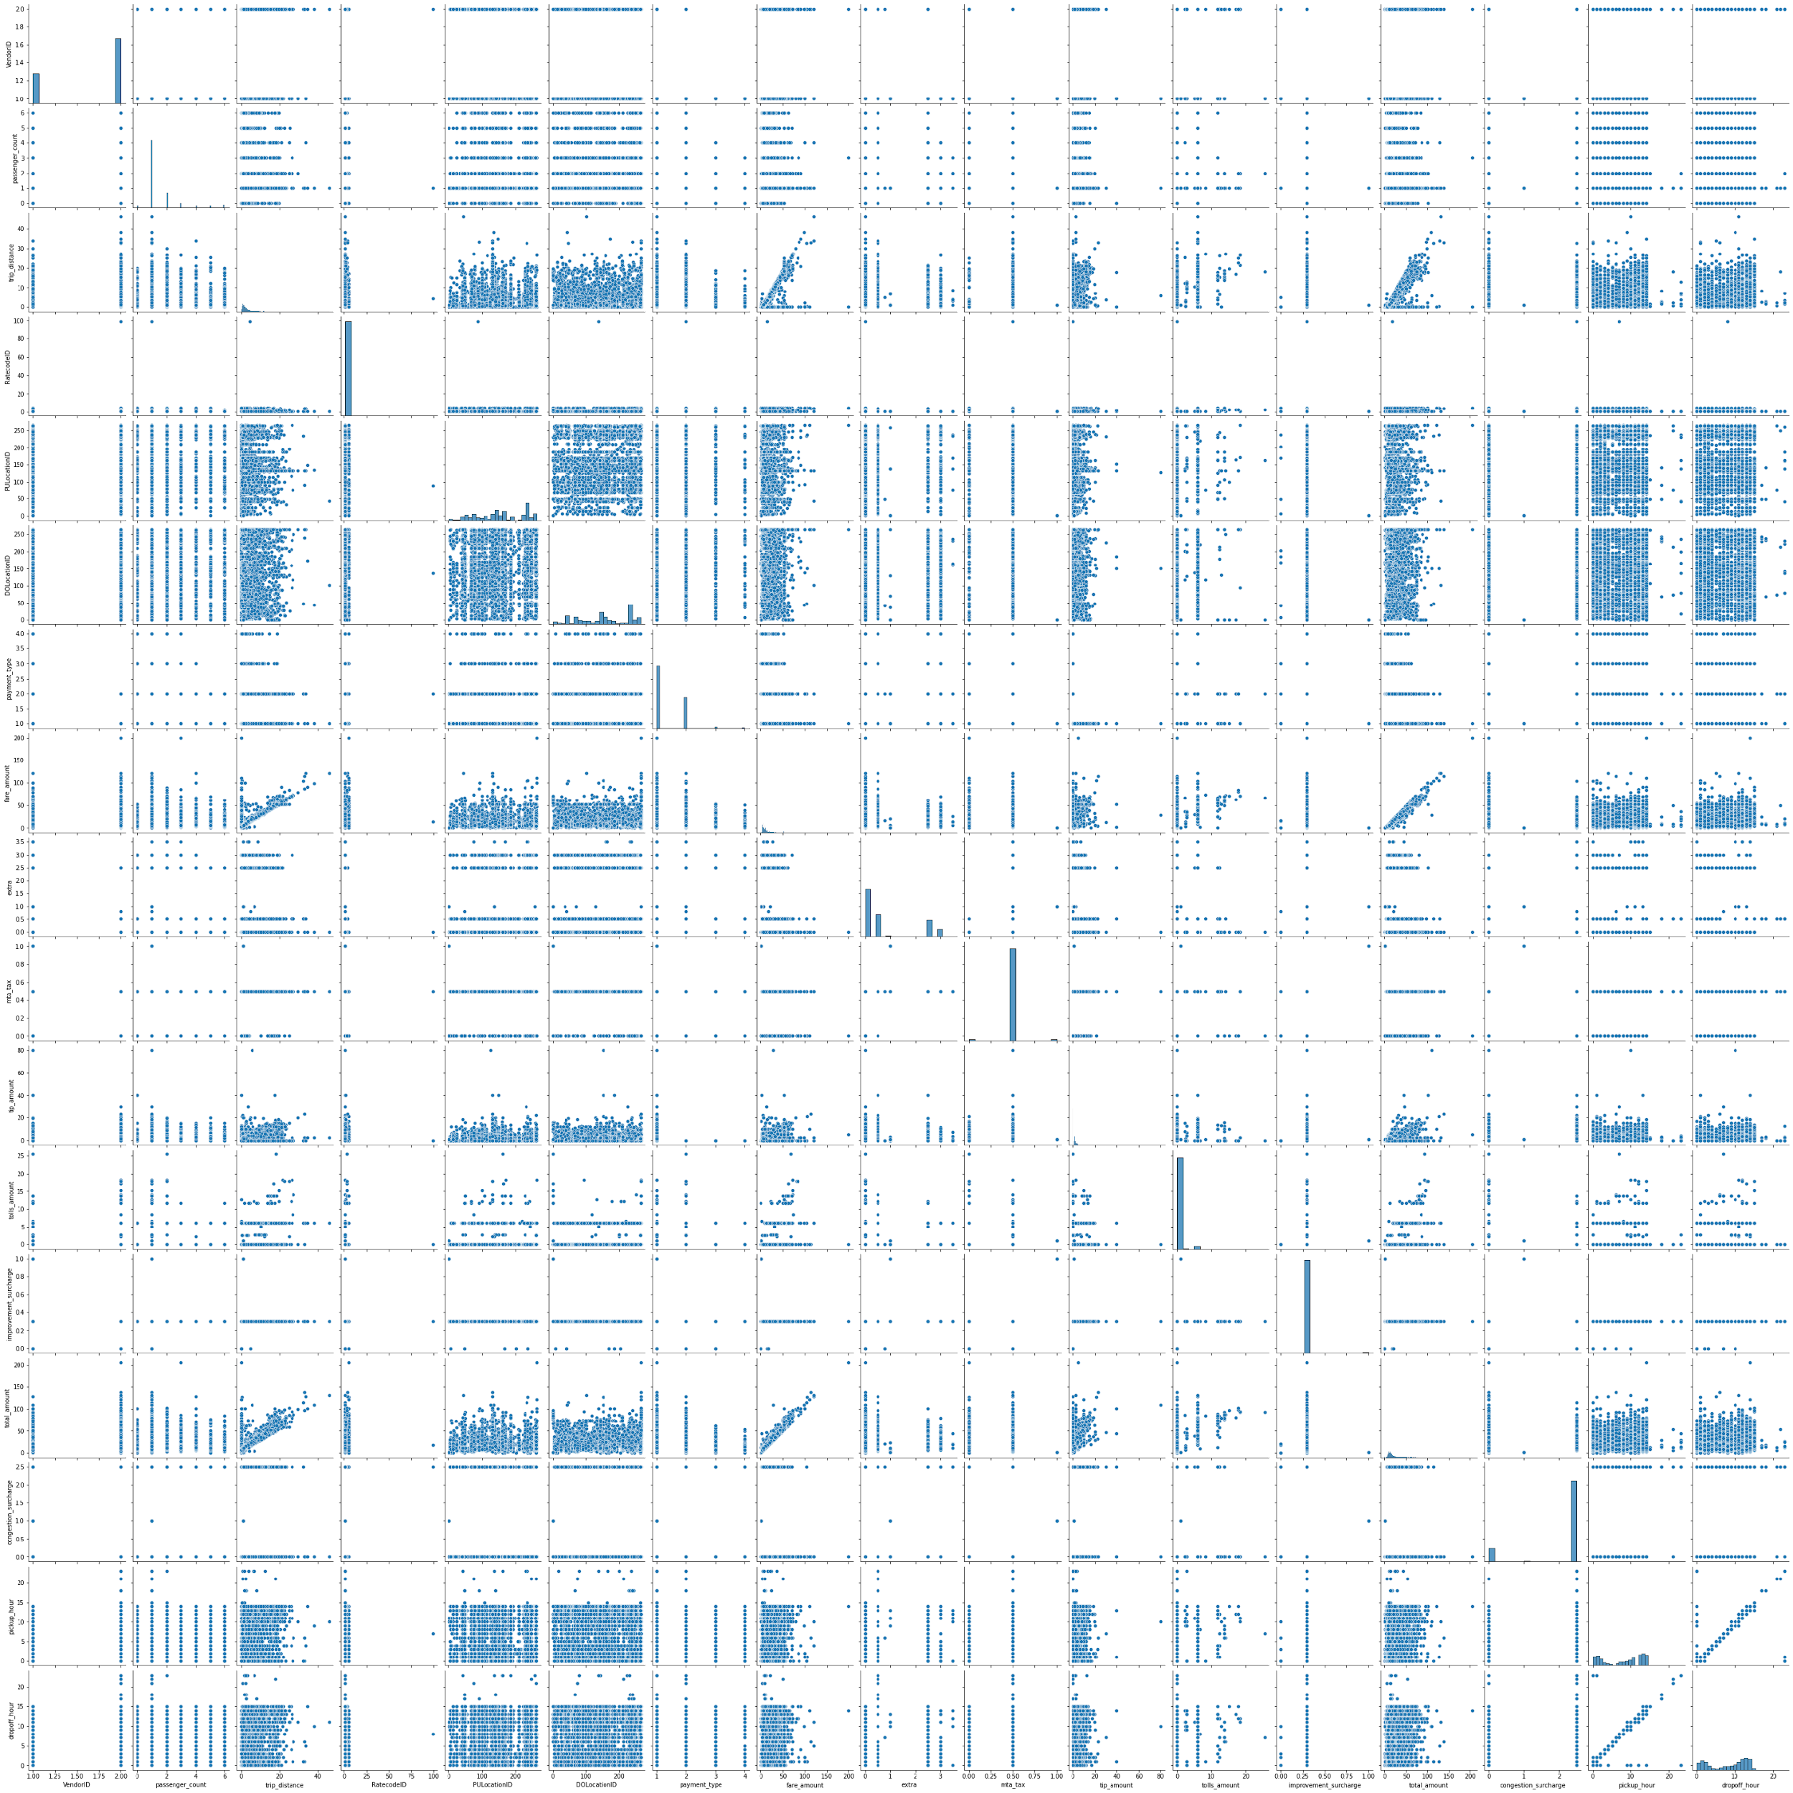
A pairplot plot a pairwise relationships in a dataset. The pairplot function creates a grid of Axes such that each variable in data will by shared in the y-axis across a single row and in the x-axis across a single column.
PAIRPLOT

Slide 13
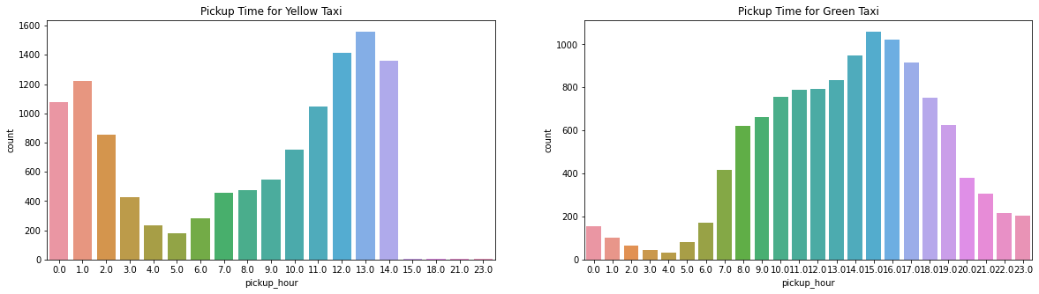
This is a normal comparison graph we have used it here to show during which time the passengers take a taxi. After observing it carefully we can see that people prefer to take yellow taxis in the afternoon hours that is between 12 to 2 pm and the green taxis are preferred between 2 to 5 pm.

Slide 14
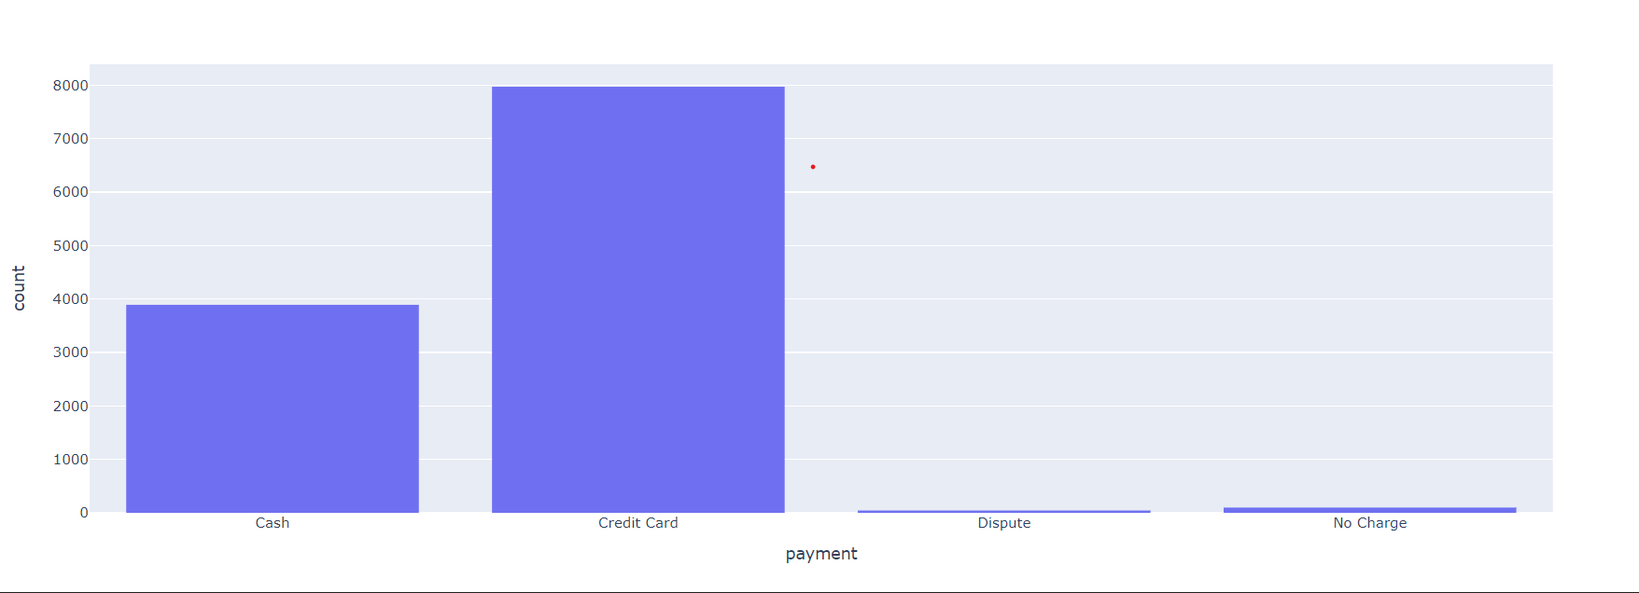
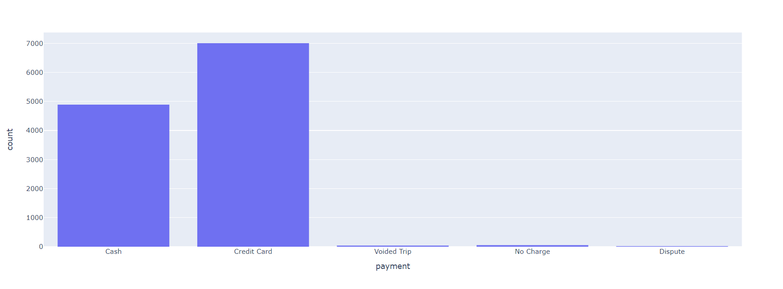
A histogram is used to display frequency variation of the data. Here we have used it to show the preferred payment methods of the customers while taking a taxi trip.
HISTOGRAM
NYC YELLOW TAXI
NYC GREEN TAXI

Slide 15
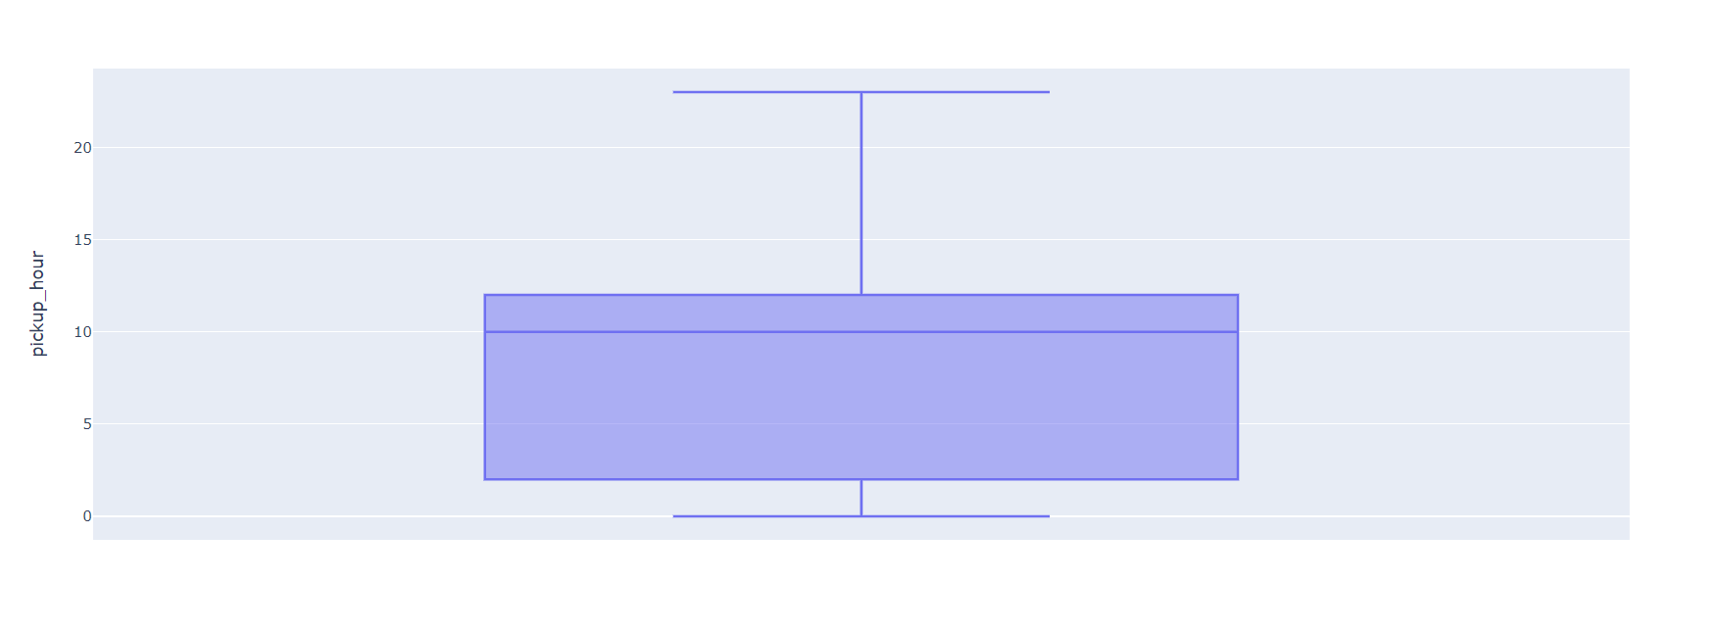
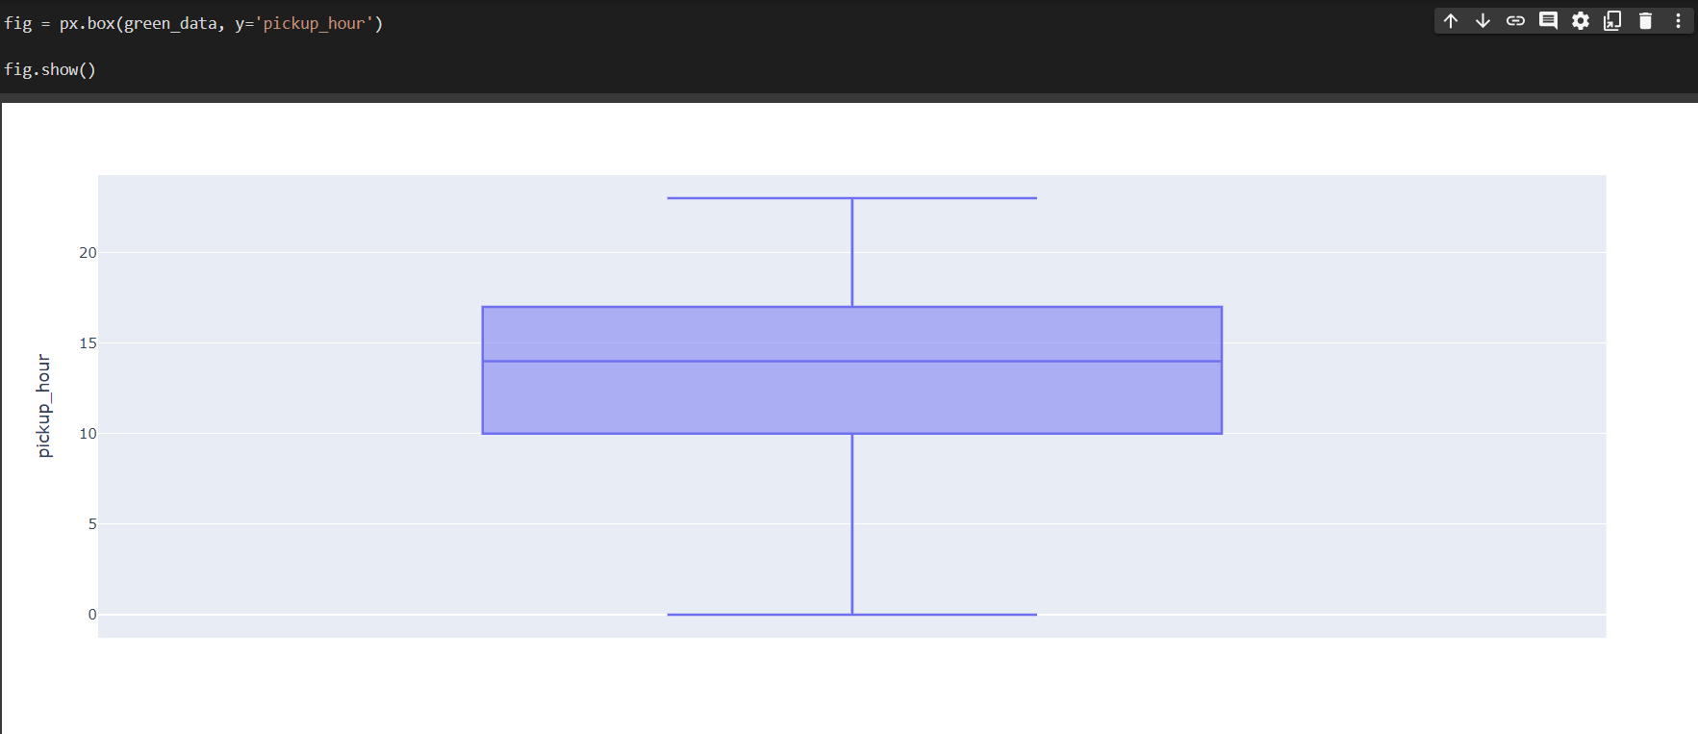
Boxplots are used to show how well distributed the data in a data set is. Here we have used to show the distribution of pick up hour.
BOXPLOT
NYC YELLOW TAXI
NYC GREEN TAXI

Slide 16
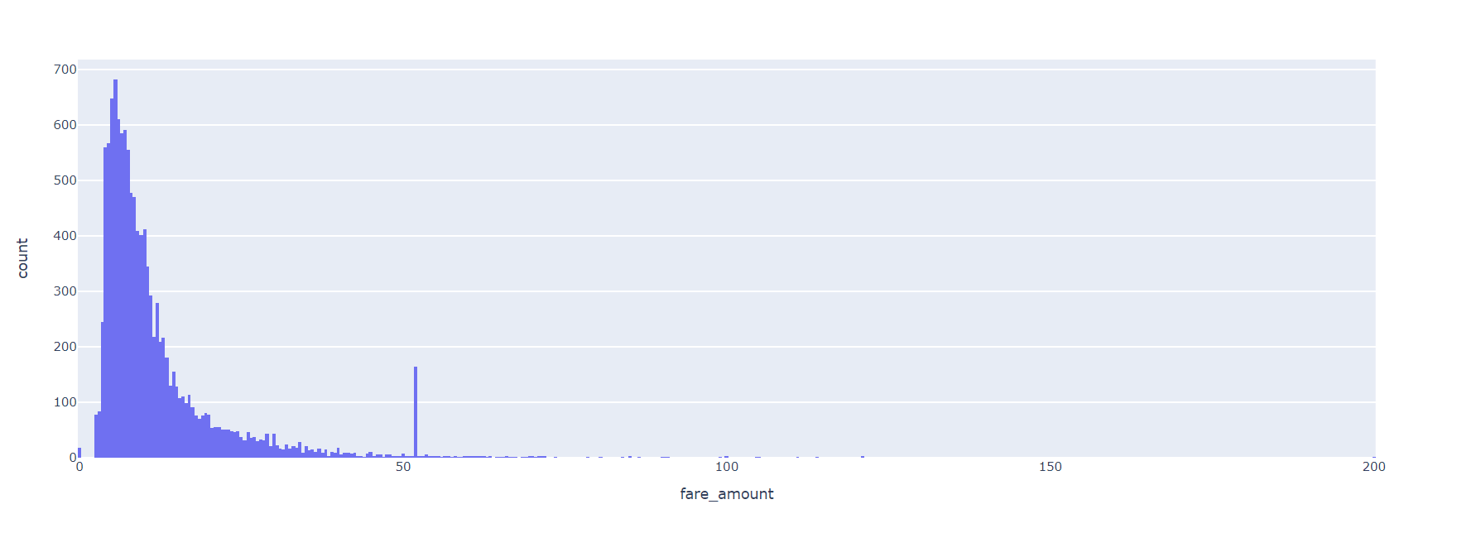
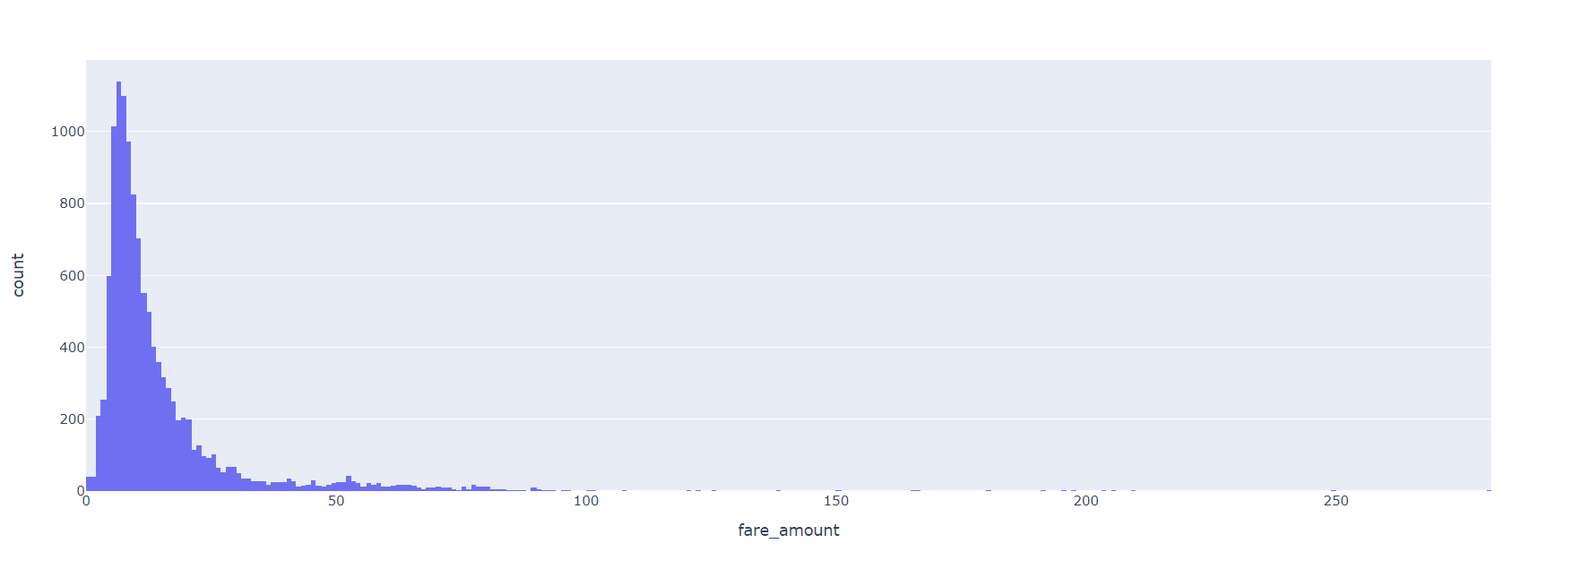
The below histogram shows the frequency variation of the fare amount.
HISTORGRAM
NYC YELLOW TAXI
NYC GREEN TAXI

Slide 17
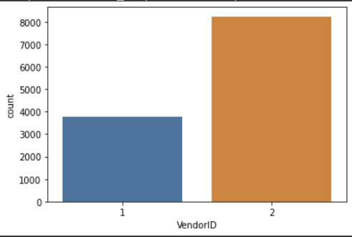
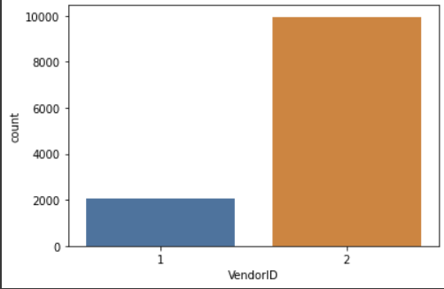
Countplot shows the counts of observations in different categorical bin using bars. Here we have used it show the counts of taxis owned by different vendors.
COUNTPLOT
NYC YELLOW TAXI
NYC GREEN TAXI

Slide 18
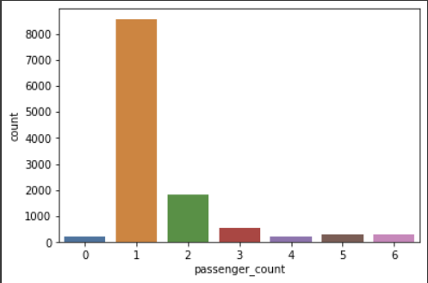
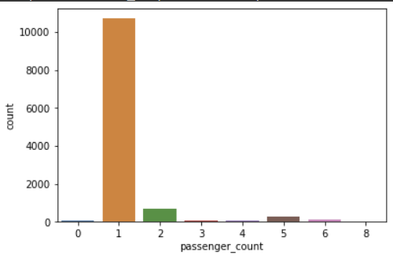
The below countplots show the trips taken by different number of passengers.
COUNTPLOTS
NYC YELLOW TAXI
NYC GREEN TAXI

Slide 19
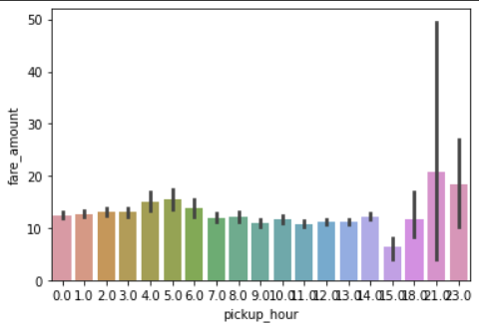
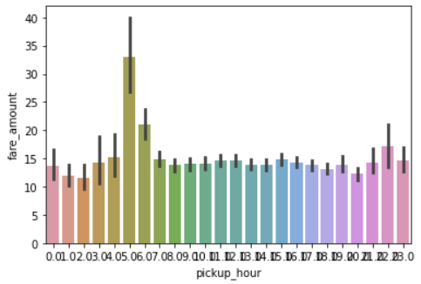
A barplot is used to display the relationship between a numeric and a categorical variable. We have used it show how the fare amount varies according to the pick up times.
BARPLOT
NYC YELLOW TAXI
NYC GREEN TAXI

Slide 20
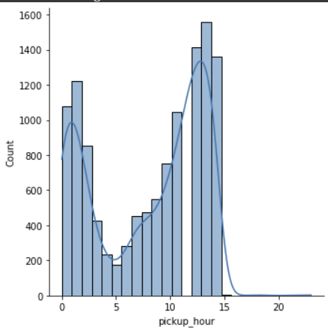
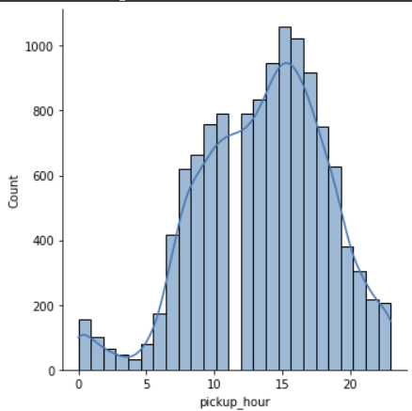
A Distplot or distribution plot is used to depict the variation in the data distribution. We have used it to show the variation in the pick up hour.
DISPLOT
NYC YELLOW TAXI
NYC GREEN TAXI

Slide 21
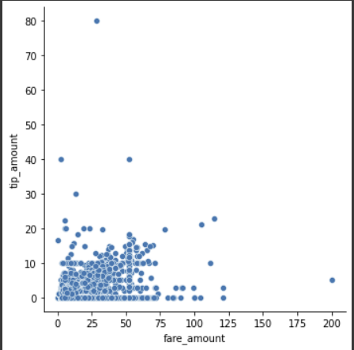
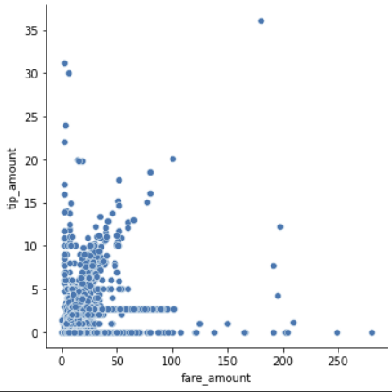
Scatter plot is used to compare two sets of data along the two axes. It is used to visualize the relationship between the two variables. Here we have used it to show the relation between the fare amount and the tip amount.
SCATTER PLOT
NYC YELLOW TAXI
NYC GREEN TAXI

Slide 22
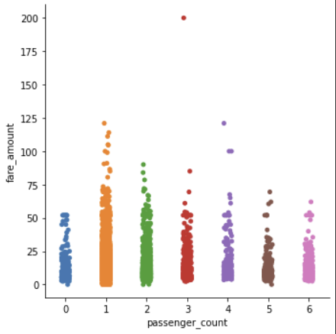
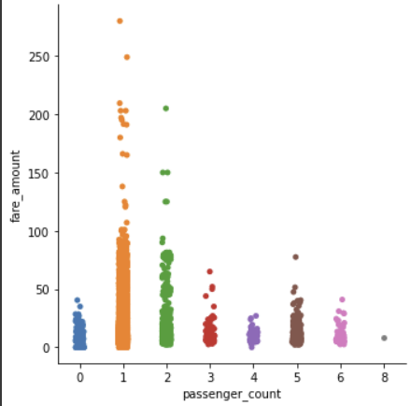
Catplot shows frequencies of the categories categorical variables. Here it shows the frequency of number of passengers to the fare amount.
CATPLOT
NYC YELLOW TAXI
NYC GREEN TAXI

Slide 23
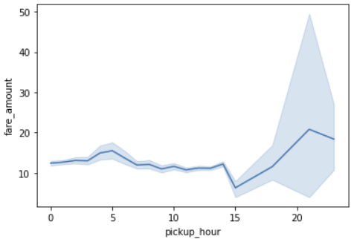
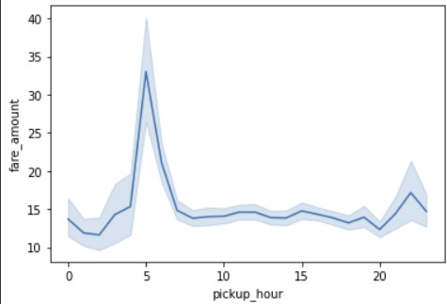
A lineplot uses lines to connect individual data points. The above lineplots show how the fare amount varies according to passenger count.
LINEPLOT
NYC YELLOW TAXI
NYC GREEN TAXI

Slide 24
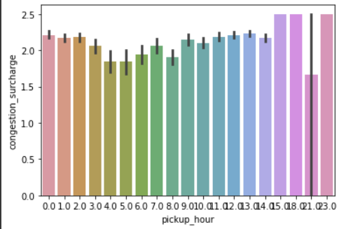
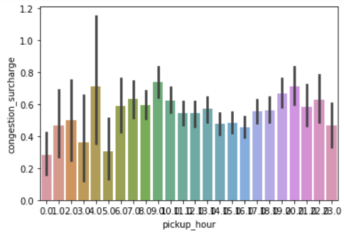
A barplot is used to display the relationship between a numeric and a categorical variable. We have used it show how the congestion surcharge amount varies according to the pick up times.
BARPLOT
NYC YELLOW TAXI
NYC GREEN TAXI

Slide 25
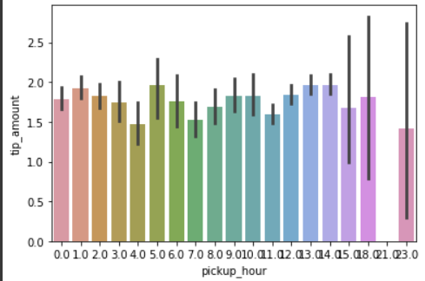
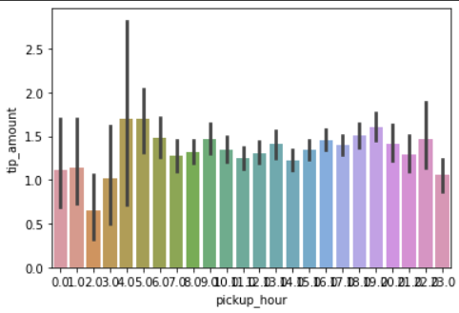
The below barplots show how the amount of tips varies according to the pick up time.
BARPLOT
NYC YELLOW TAXI
NYC GREEN TAXI

Slide 26
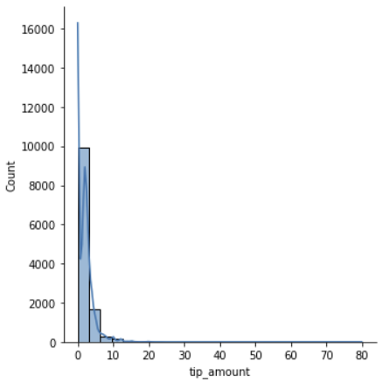
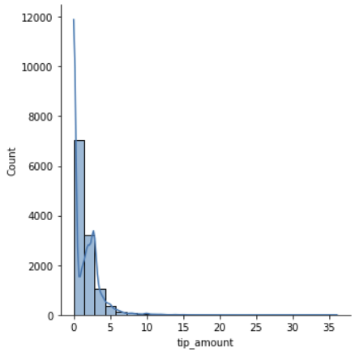
Distplot helps to show a histogram with a line on it with all kinds of variations. Here we show the frequency of the tip amount.
DISPLOT
NYC YELLOW TAXI
NYC GREEN TAXI

Slide 27
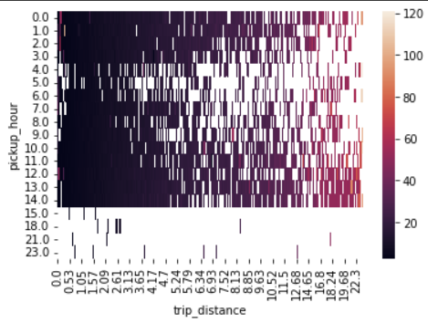
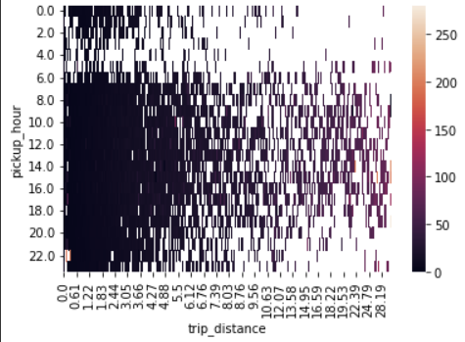
A heatmap contains values representing various shades of the same colour for each value to be plotted. the darker shades of the chart represent high frequency. This shows the relationship between trip_distance and pickup_hour.
HEATMAP
NYC YELLOW TAXI
NYC GREEN TAXI

Slide 28
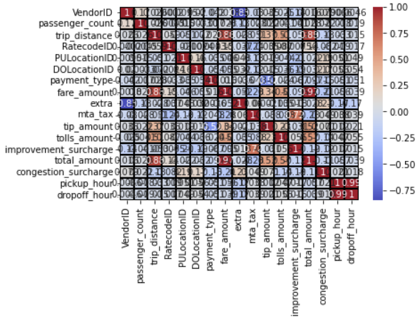
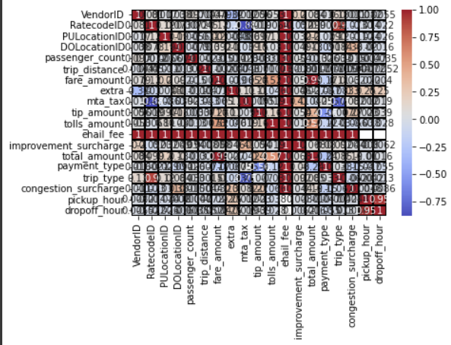
A heatmap contains values representing various shades of the same colour for each value to be plotted. the darker shades of the chart represent highest frequency. The below heatmap shows the correlation between all the columns.
HEATMAP
NYC YELLOW TAXI
NYC GREEN TAXI

Slide 29
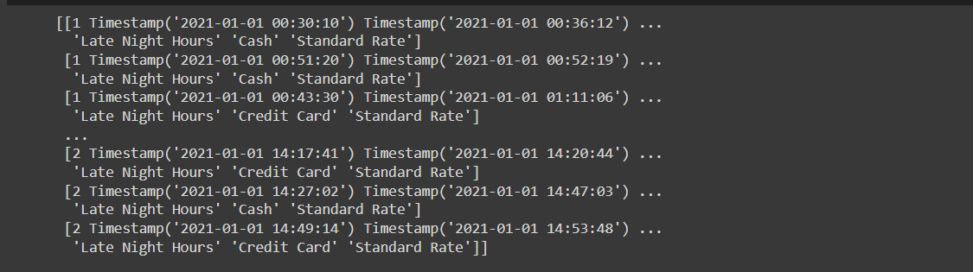
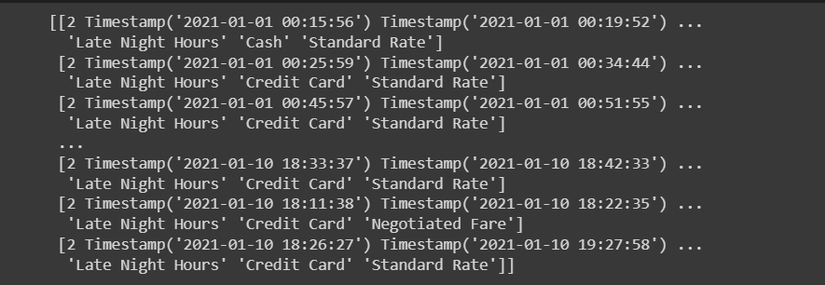
UPLOADED DATA TO NUMPY
NYC YELLOW TAXI
NYC GREEN TAXI

Slide 30
RESULT
In our exploratory data analysis we found out that yellow taxis are preferred over green taxis. People prefer to travel alone in the taxis and they prefer to pay using credit cards more than cash payments.

Slide 31

CONCLUSION
Using the datasets for the Yellow and Green taxi we tried to find the variation in the tip amounts, the preferred payment methods of the customer, how the tips vary according to the pick up time and also from this analysis we got to know that people prefer yellow taxis as they are available all over NYC.

Slide 32
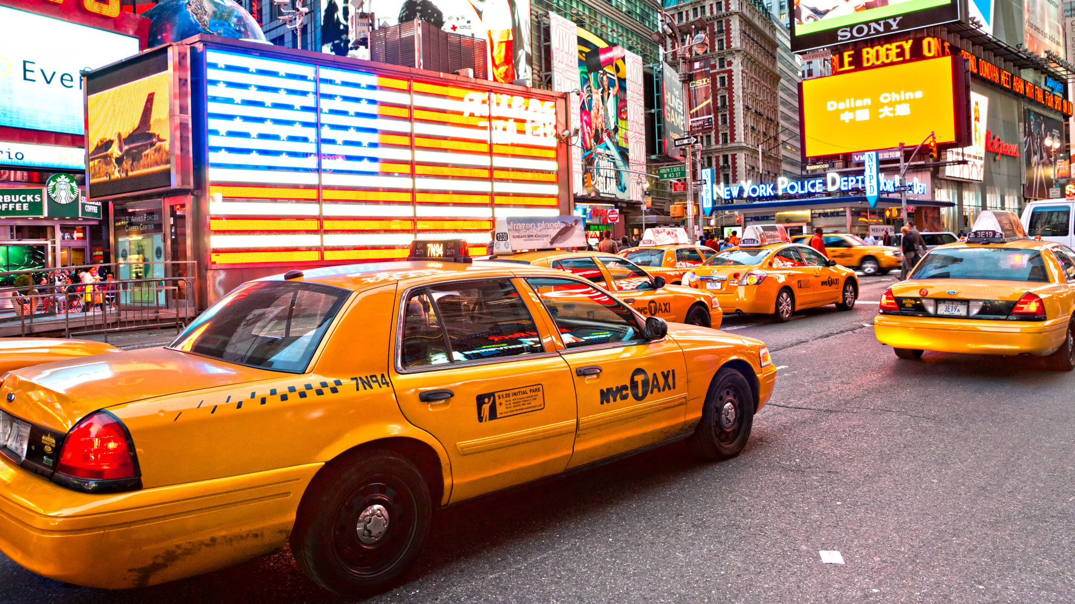
REFERENCES
Python Data Analysis and Visualization - Learn Interactively (educative.io)
Python Seaborn Tutorial – GeeksforGeeks
Classes - Python Programming SPRING 2022 27960 (pace.edu)

Slide 33

THANK YOU

